Slide 1

8 Bit MP3 Player
First Year B. Tech Trimester 2 2021-2022
BEEE (ECE1022A) PBL Activity By Krishnaraj Thadesar
Division 9, 109054 (I3) , 1032210888

Slide 2
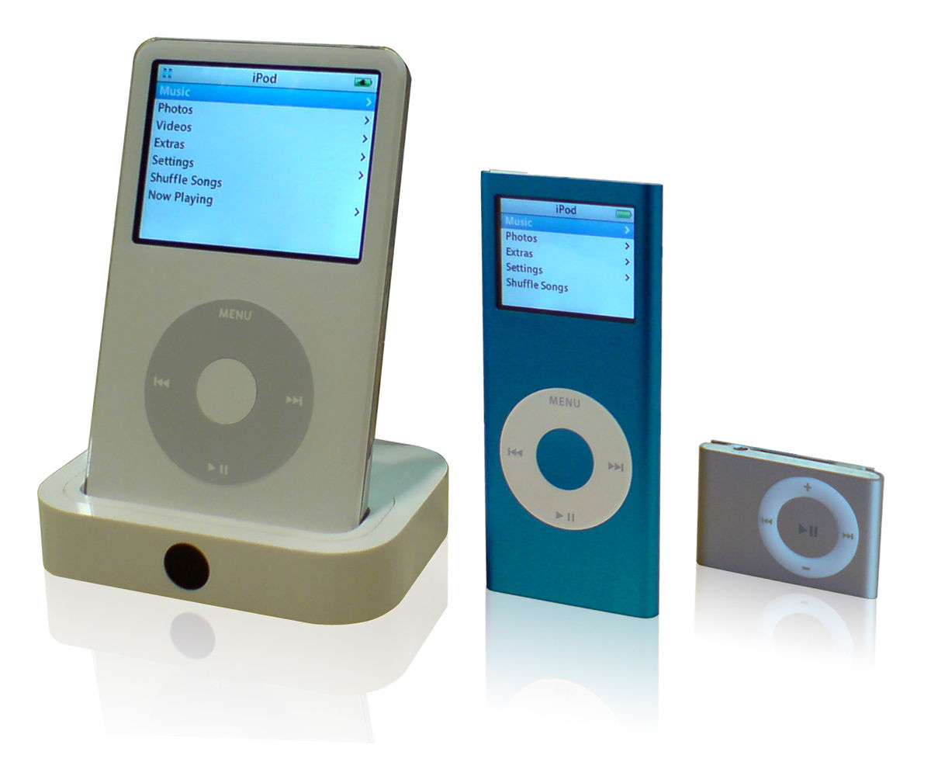
Introduction
An Mp3 Player is a device that has only one purpose, which is to play Mp3 files or songs.
It can sometimes include a Display to let you know which song is being played, and what the next songs are.
8 Bit Music got its name from Music generated from PSG(programmable Sound Generator) Chip, located usually on 8-bit Microprocessors as opposed to Modern 64 Bit ones. It uses limited Frequencies to create any sound or tune.
In This project we will use Arduino Uno which uses an ATMega328 chipset, which is an 8 Bit processor combined with an LCD Screen to make a very simple Music Player.

Slide 3
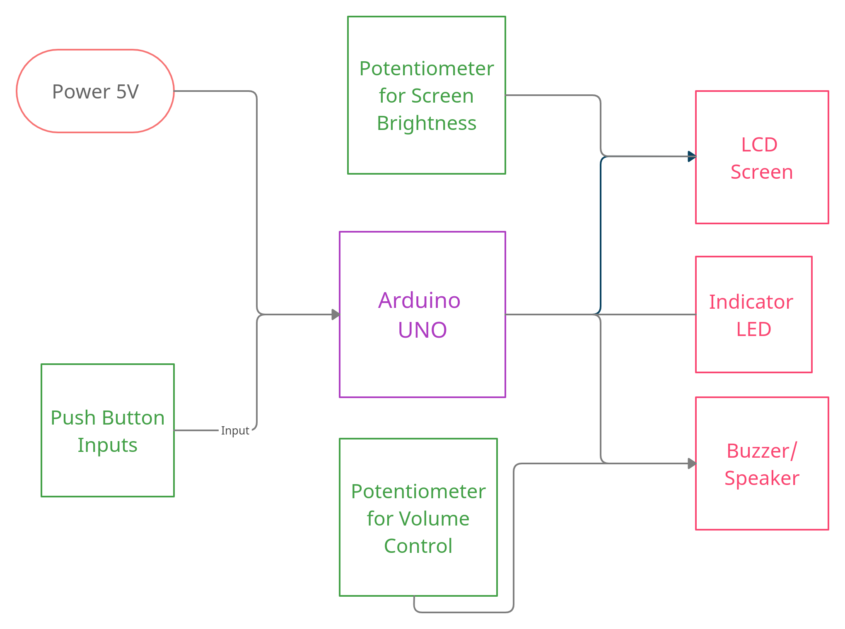
Block Diagram

Slide 4
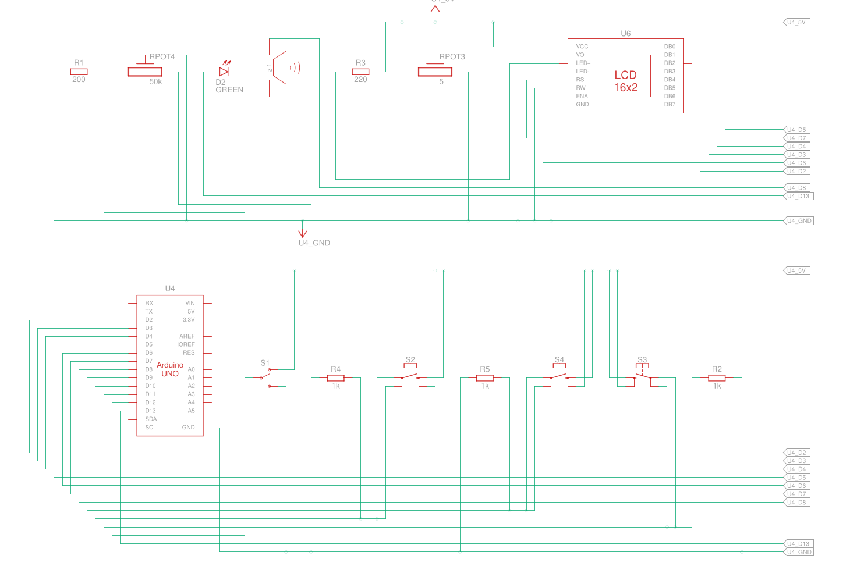
Circuit Diagram

Slide 5
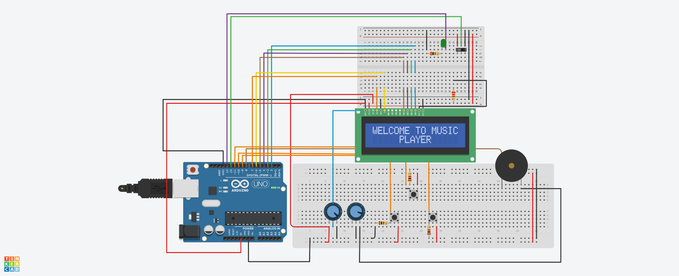
Simulation Screenshots

Slide 6
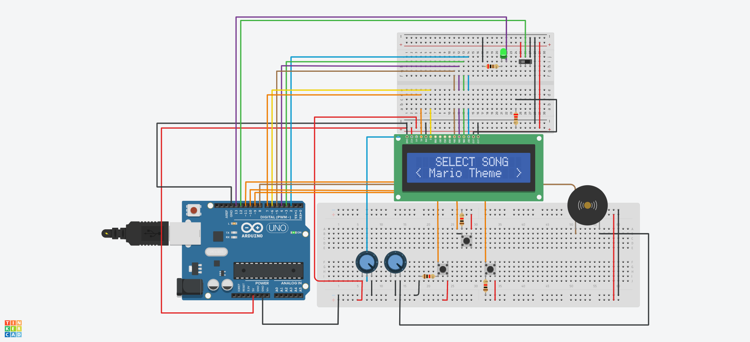

Slide 7
Components Used
Name | Quantity | Component
U4 | 1 | Arduino Uno R3
U6 | 1 | LCD 16 x 2
PIEZO2 | 1 | Piezo
D2 | 1 | Green LED
S2, S3, S4 | 3 | Pushbutton
Rpot3 | 1 | 5 Ω Potentiometer
Rpot4 | 1 | 50 kΩ Potentiometer
R3 | 1 | 220 Ω Resistor
R1 | 1 | 200 Ω Resistor
R4, R2, R5 | 3 | 1 kΩ Resistor
S1 | 1 | Slideswitch

Slide 8
Applications
An Arduino being far superior than required for a project like this one, would make it impractical to buy and use, but the Chipset, and certain music ICs paired with the same arrangement as in this project can be used to make a good 8-Bit Music Player.
The Arduino itself has numerous Applications like: Weighing Machines.
Traffic Light Count Down Timer.
Parking Lot Counter.
Embedded systems.
Home Automation.
Industrial Automation.
Medical Instrument.
Emergency Light for Railways.
The LCD Screen can also be used to display anything from a clock, a timer, weights, Temperatures, or any needed value, cheaply and easily.
More Songs can be programmed and added to then put this into something very small and portable for a quick, simple and cheap Music Player.

Slide 9
Improvements that can be made
The Expensive Arduino can be replaced with the chipset used inside or another Music IC coupled with another cheaper Microprocessor IC to reduce the cost (while increasing the complications) of the Project.
A Better Buzzer can be used for better sound Quality
A Program can be written that automatically converts any song into its 8 Bit code version so it becomes easy to add new songs, instead of hard coding them into the Aruduino.
An External Storage of some sort can be added like an SD Card to store Thousands of other Songs.
All The components can be put in a small Enclosing for increasing Portabitlity.

Slide 10
Learning Experience
I got to interact with the Basic LCD Screen, and so now that can be used in many other places, which is an important output device.
Exposure to a Microprocessor and working on such a low level of input and output gave a better and more open idea about the working of a computer.
2 Terminal Switches are basic, but 3 terminal switches with a ground pin make use of more Electrical concepts which were put to use by actually using them. This also forced me to learn the basics of the Potentiometer and its detailed working.
Programming the Basics of Music also made me learn some Music Theory, reading some music notes, and an in depth working of a speaker.

Slide 11
Conclusion
A very simple 8-bit Music Player was made, programmed and Built in Tinkercad successfully.
The Working, Programming, and basic functioning of the Arduino, a Buzzer, an LCD Screen, Switches and Potentiometer was studied and Applied in detail.

